Slide 1
Comment Service Design

Slide 2
Introduction
Introduction
Name: Sachin Dhanoriya
Current Company: Salesforce
Designation: Member of Technical Staff
Experience: 6+ years

Slide 3
Agenda
Agenda
Functional Requirements
Non-Functional Requirements
Assumptions and Capacity Estimations
API Design
High Level Design
Assumptions and Approach
Low Level Design
Database Design
Entity Relationships
Class Designs
Extensibility, Resiliency, and Scalability Considerations
QA

Slide 4
Functional and Non-Functional Requirements
Functional Requirements
User should be able to –
View and post comments on posts, comments and comments of comments.
Like and dislike a post and comment and should be able to see other users who did so as well.
Non-Functional Requirements
Highly Scalable:
As it should be able to support 1000s of comments to any post or comment and 100s of levels of comment nesting. Assuming as this is a Social Media website, it should be handling millions of users, approx. 100 millions.
Highly Available:
As this is a Social Media site and our operations do not require strict Transactional guarantees.
Low Latency:
To improve user experience, app should be responsive.
Eventually Consistent:
To support High Availability and Low Latency, we need to rely on Eventual Consistency model.

Slide 5
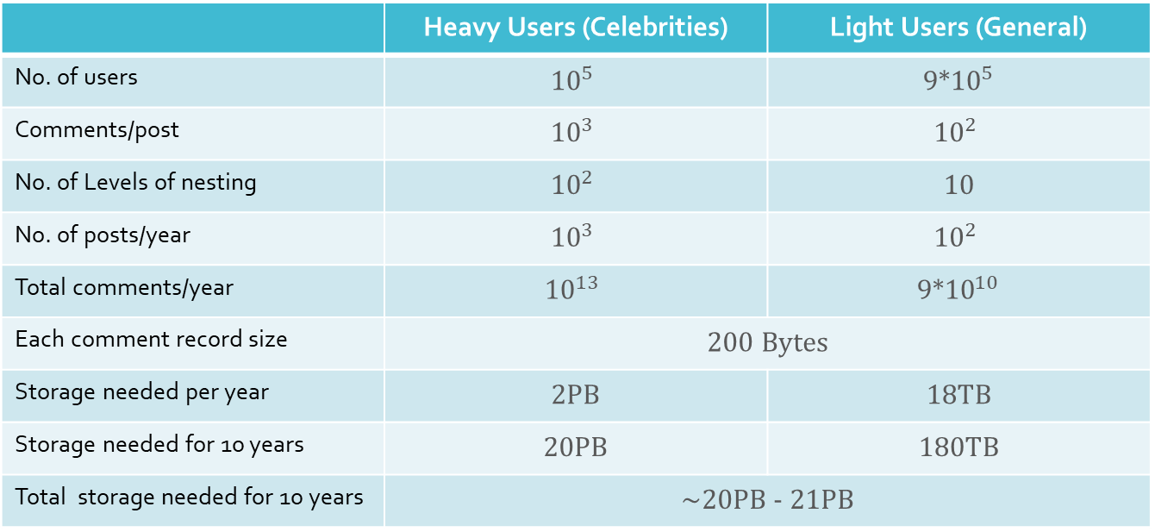
Assumptions and Capacity Estimation
Assumptions and Capacity Estimation
No of users: 1 millions | 10% are heavy users (e.g. celebrities) and 90% are generally light users.
 | Heavy Users (Celebrities) | Light Users (General)
No. of users | $${10}^{5}$$ | 9*${10}^{5}$
Comments/post | $${10}^{3}$$ | $${10}^{2}$$
No. of Levels of nesting | $${10}^{2}$$ | 10
No. of posts/year | $${10}^{3}$$ | $${10}^{2}$$
Total comments/year | $${10}^{13}$$ | 9*${10}^{10}$
Each comment record size | 200 Bytes
Storage needed per year | 2PB | 18TB
Storage needed for 10 years | 20PB | 180TB
Total storage needed for 10 years | ~20PB - 21PB
If a user record takes 100B, therefore, total user table size = ${10}^{8}$B = 100MB

Slide 6
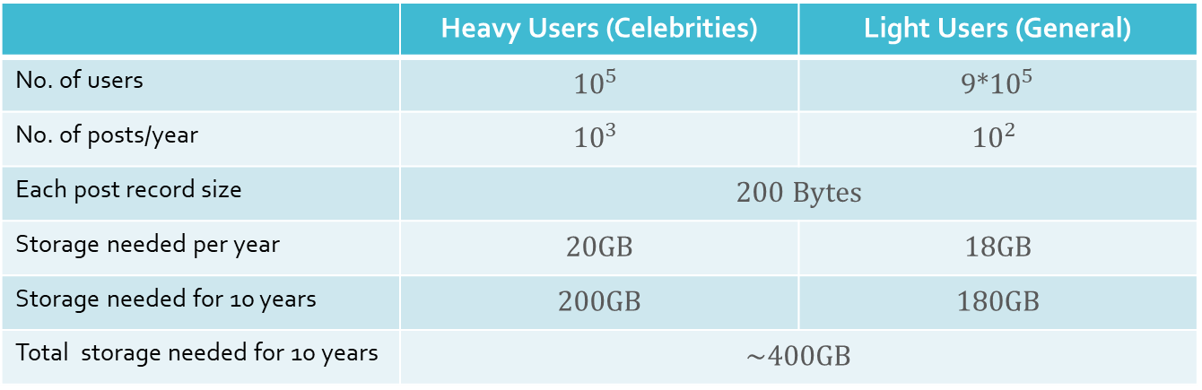
Assumptions and Capacity Estimation
Assumptions and Capacity Estimation
No of users: 1 millions | 10% are heavy users (e.g. celebrities) and 90% are generally light users.
 | Heavy Users (Celebrities) | Light Users (General)
No. of users | $${10}^{5}$$ | 9*${10}^{5}$
No. of posts/year | $${10}^{3}$$ | $${10}^{2}$$
Each post record size | 200 Bytes
Storage needed per year | 20GB | 18GB
Storage needed for 10 years | 200GB | 180GB
Total storage needed for 10 years | ~400GB
With these assumptions, calculations, and data volume considerations, NoSQL solutions like Cassandra works well for comments database and SQL solutions would be good enough for storing users and posts information.
*Note: For the sake of simplicity, I’m using RDMBS solution to store both the tables i.e., Comments and Users tables.

Slide 7
REST API Design
REST API Design
Assuming that page size for pagination will be provided by the UI. Otherwise, it can be configured in the application properties.
GET /comments/<postId>?pages=[10|20|30]
GET /comment/replies/<commentId>?pages=[10|20|30]
GET /comment/users/likesDislikes/<commentId>?pages=[10|20|30]
POST /comment Body:content-type json {“parentCommentId”: <id>, “commentText”: “…”, … }
PATCH /comment/like/<commentId>?userId=<userId>,pages=[10|20|30]
PATCH /comment/dislike/<commentId>?userId=<userId>,pages=[10|20|30]
PATCH /comment Body:content-type json {“parentCommentId”: <id>, “commentText”: “…”, … }
DELETE /comment/<commentId>
DELETE /comment/like/<commentId>?userId=<userId>
DELETE /comment/dislike/<commentId>?userId=<userId>

Slide 8
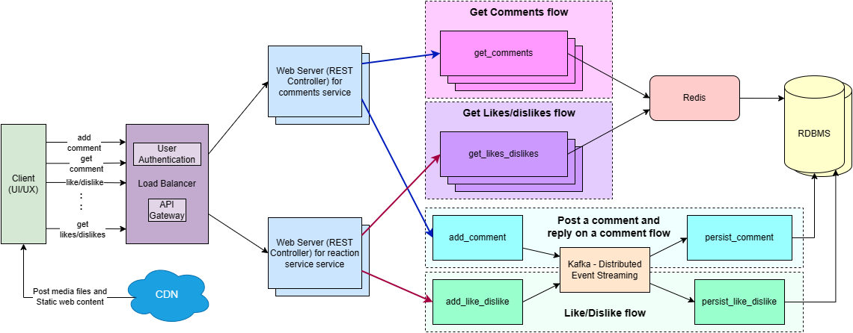
High Level Design

Slide 9
High Level Design
Considerations:
For Database solution I am using RDBMS until our userbase is small and is manageable by RDBMS.
Once the userbase starts to become moderately high, we would want to plan migrating the comments table to the new Cassandra Database.
As it’s a distributed database of A-P type i.e., highly available and eventually consistent in the presence of network partition and can handle large volumes of data, it will fit our perfectly.
During migration we can make our worker nodes writing to the DB will dually write to both the DBs and switchover to Cassandra after the migration is completed.

Slide 10
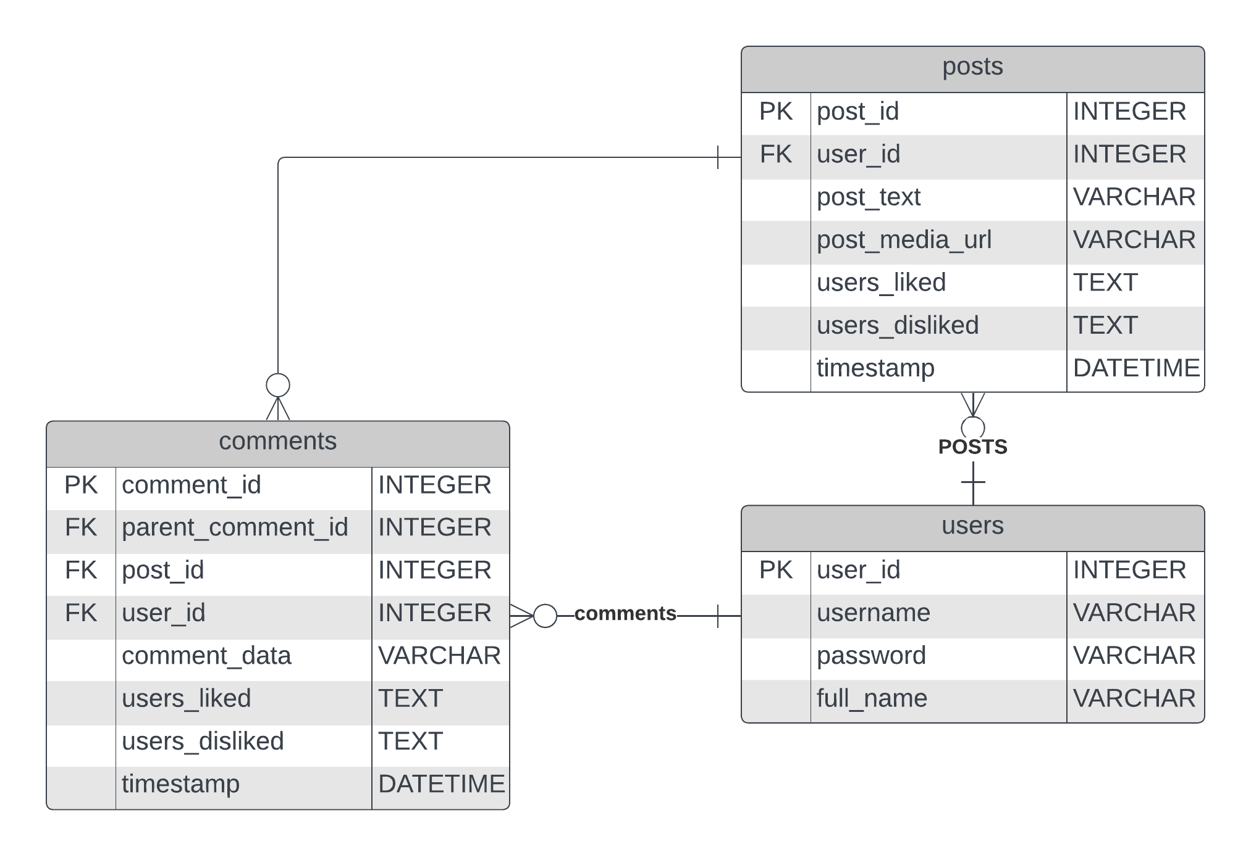
Low Level Design
Database Design and Entity Relationship Diagram

Slide 11
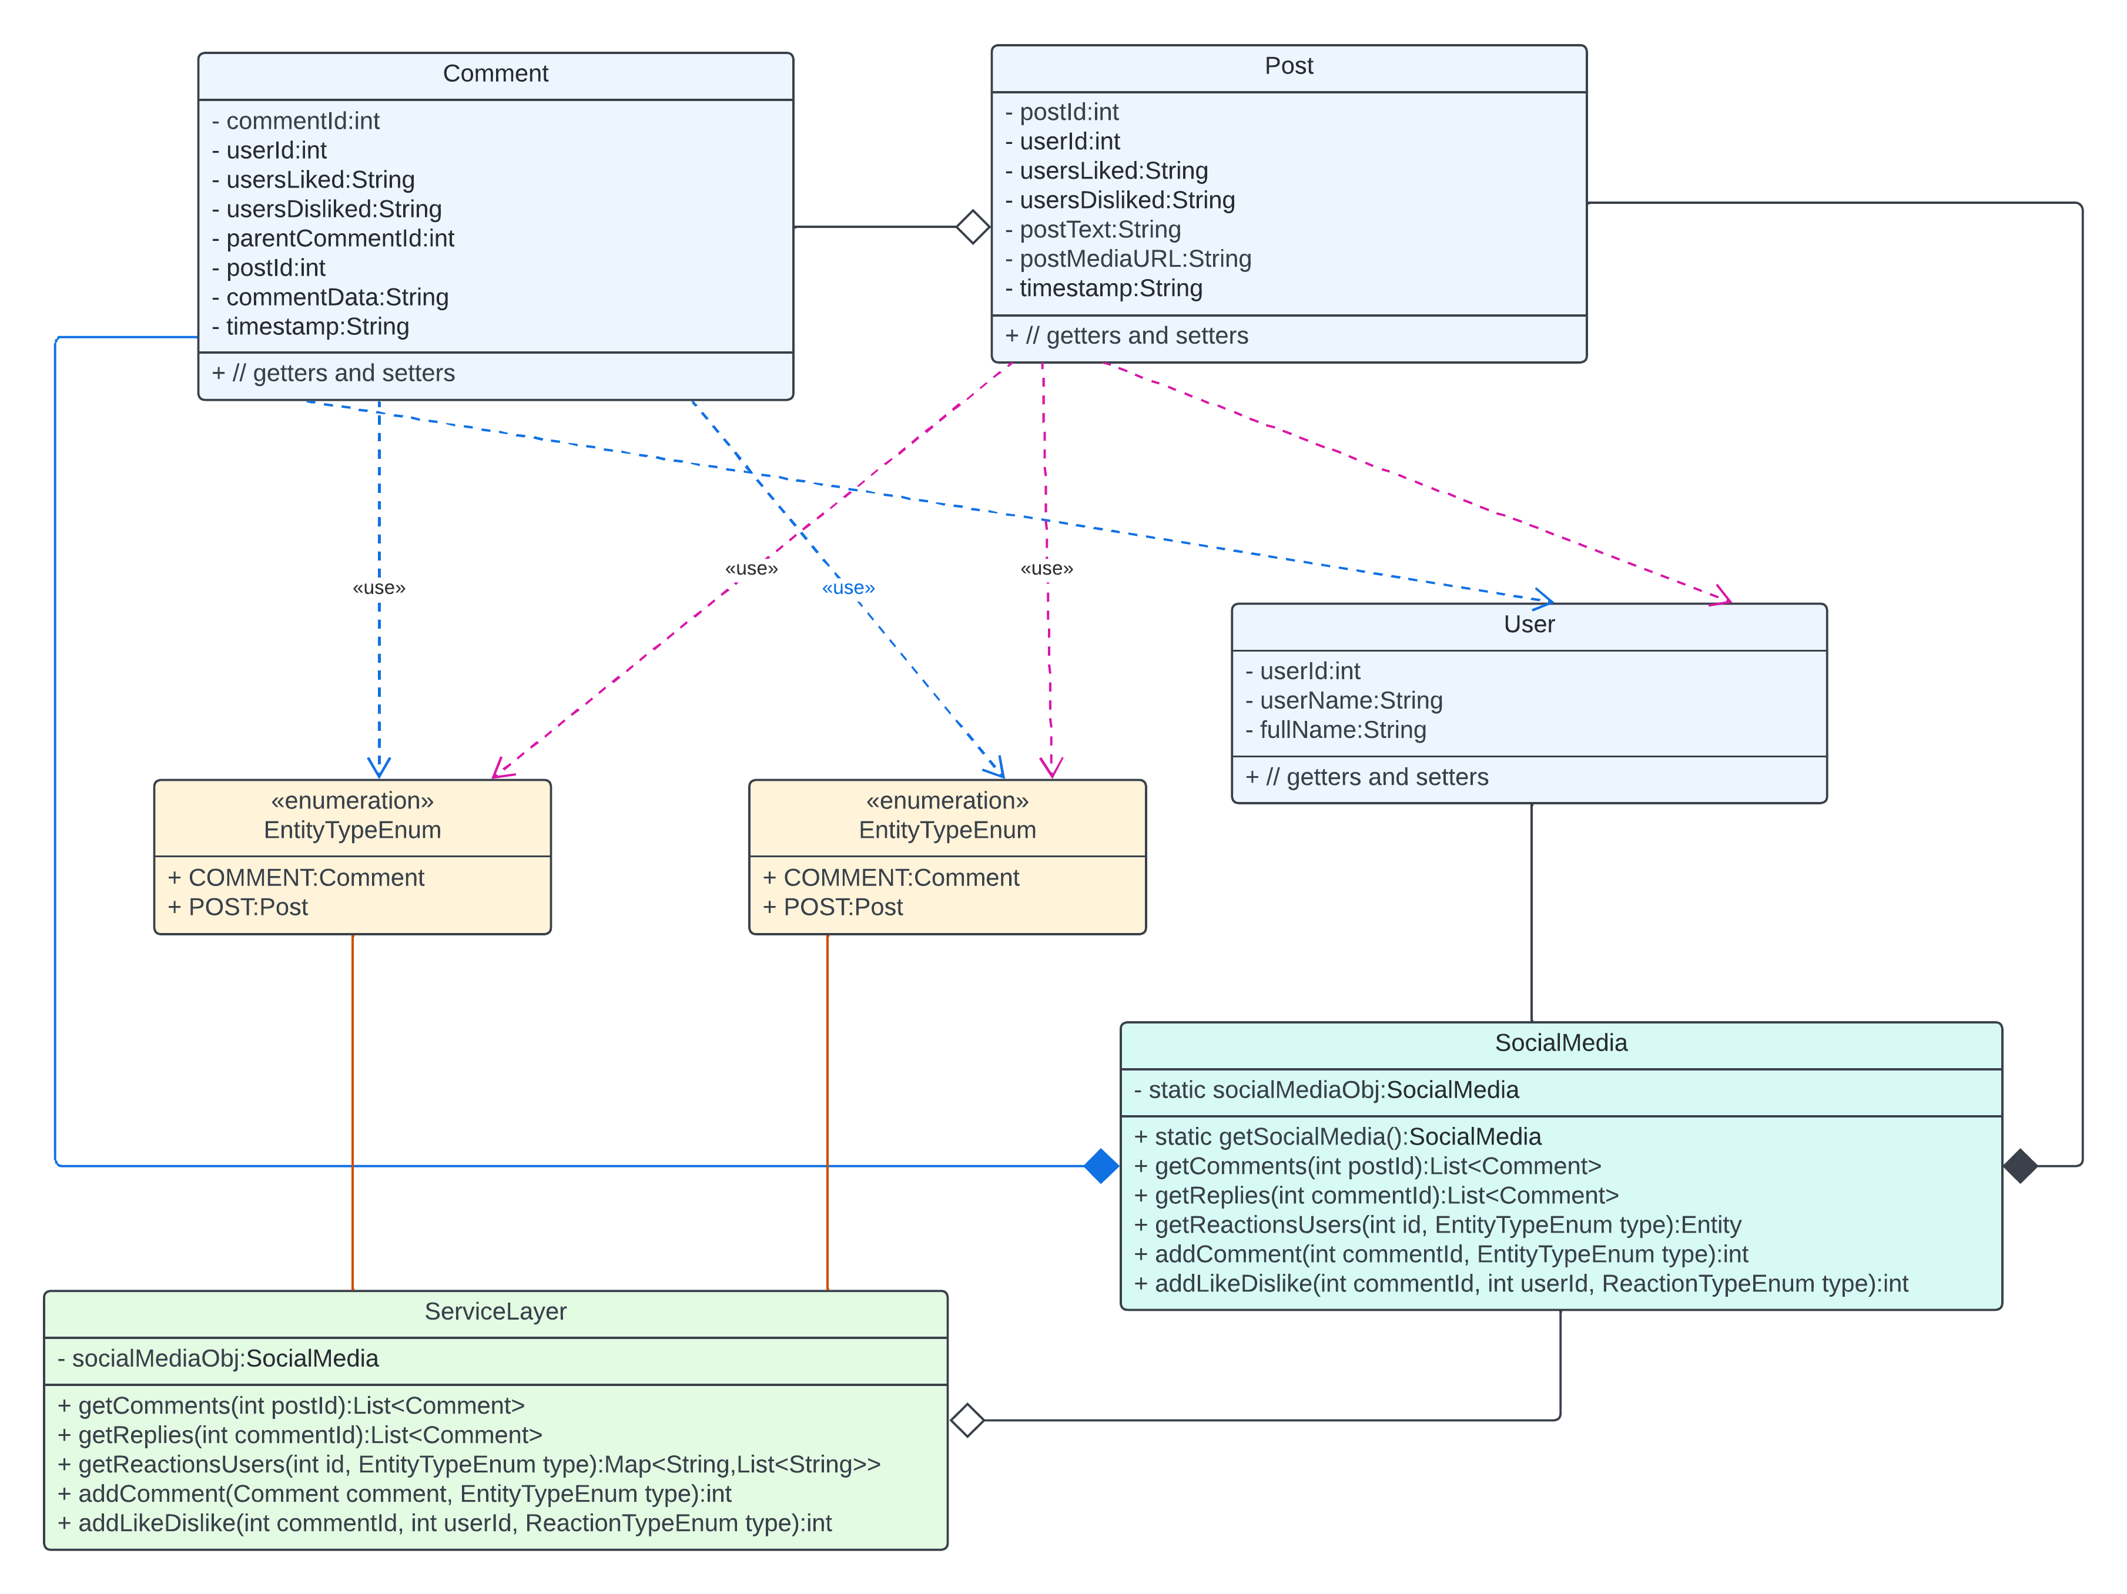
Low Level Design Class Diagram – Object Oriented Design

Slide 12
Extensibility, Resiliency, and Scalability Considerations
Our system should be extensible so that we can extend, swap and/or update the existing components without breaking other component’s workflows.
By having individual components Horizontally Scalable we make sure that our system is available as well as responsive even during the time of peak load.
To make our system resilient to faults, we make our worker nodes stateless and use replication of datastores in the distributed network.

Slide 13
Questions and Answers

